Slide 1
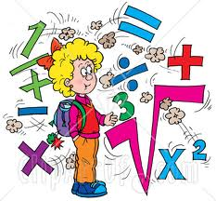
Math Maniac Day
Lee Loft
Bartlett Elementary
2nd grade

Slide 2
Making shapes

Slide 3
Circle

Slide 4
Heart

Slide 5
Hearts and a triangle

Slide 6
Hexagon

Slide 7
Square

Slide 8
Pentagon

Slide 9
Using dice to add and subtract

Slide 10
Face cards to determine greater than, less than, and equal

Slide 11
Tessellations

Slide 12
Greedy Triangle- Reader’s Theater

Slide 13
Paper Clip Estimation

Slide 14
Favorite Candy Bar Graph

Slide 15
Shape Projects
The students took pictures of shapes found in every day life.
They had to find: circles, triangles, squares, rectangles, ovals, pentagons, hexagons, octagons, arrows, stars, heptagons, and nonagons.
They compiled their photographs or creations in a booklet.

Slide 16
Tootsie Roll Estimation
Use tally marks to keep track of your licks!!

Slide 17
Donald in Math Magic Land
www.google.com/.webloc

Slide 18
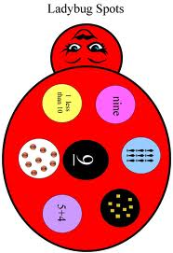
WonderBugs Celebrate Math

